Slide 1


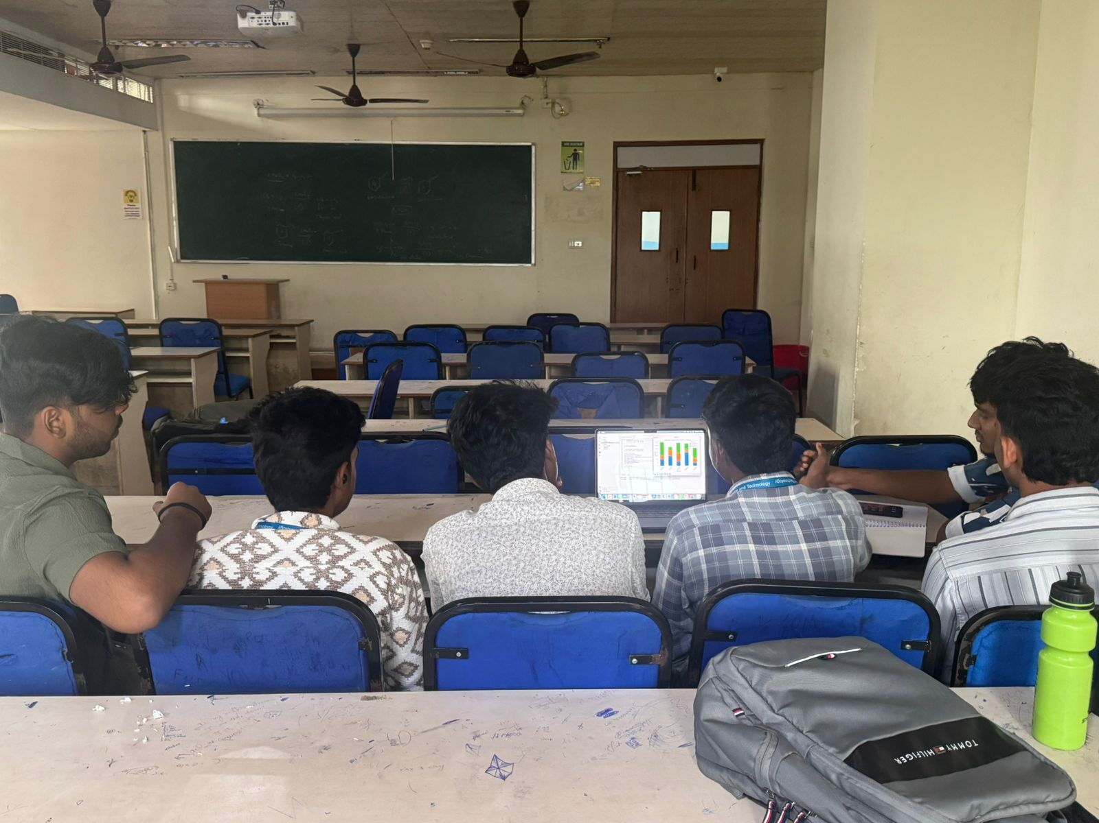

Genomic Mutation Visualization
A study on mutation frequencies across samples.
Team Members:
Sriman, Elan, Harish U, Mohit, Prajan , Vinu Vardhan

Slide 2

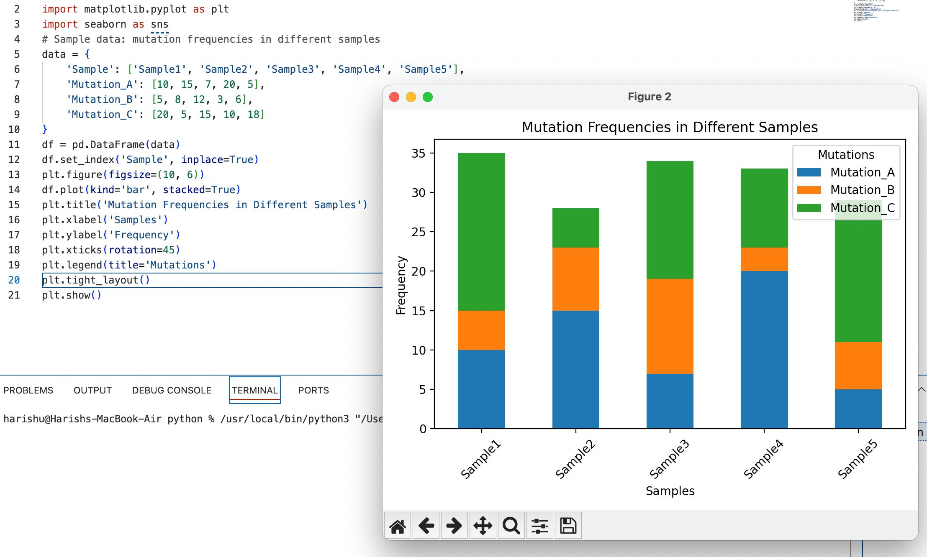
Project Overview
Introducing the project’s aim: Analyzing mutation frequencies across different samples using Python and data visualization.
Tools and libraries used: Pandas, Matplotlib, Seaborn.

Slide 3
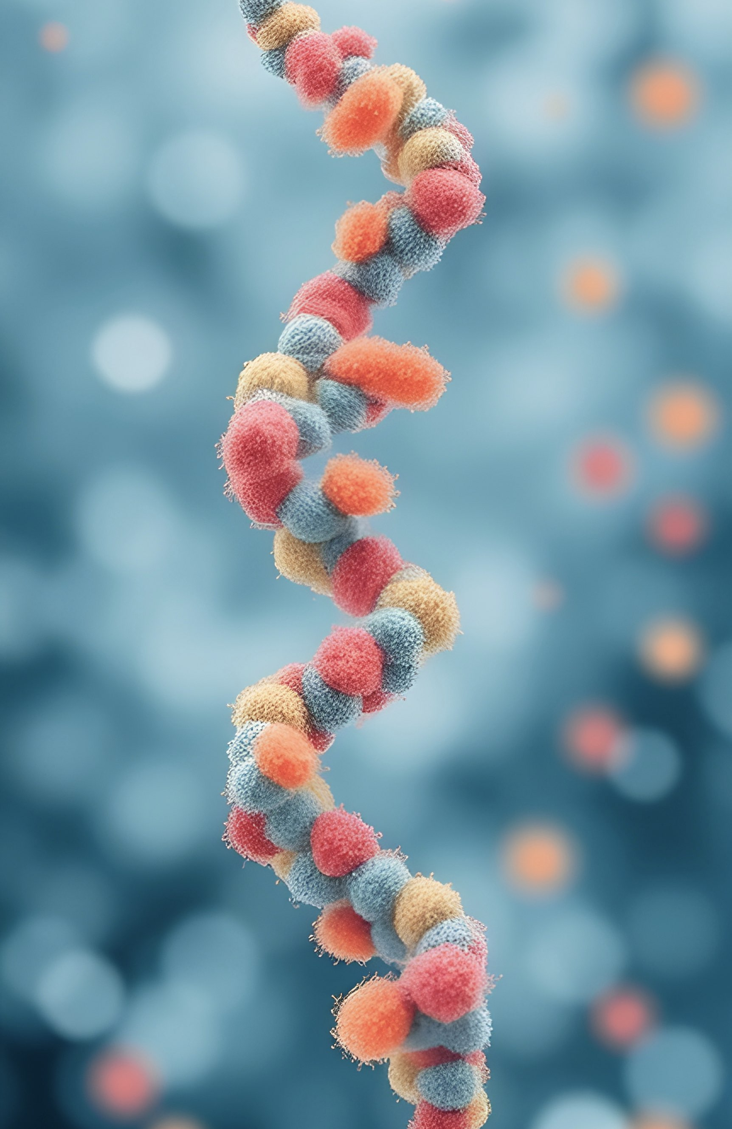
Basic Ideology
Sriman & Elan
Main goal: Understanding and visualizing mutation patterns.
Dataset: multiple samples with mutation counts for different mutation types.
Importance of visualizing this data for biological research.

Slide 4

Data Preparation
Prajan - Pandas
Used Pandas for handling and preparing the data.
Organized, cleaned, and structured data for visualization.
Code snippet for DataFrame setup shown below.

Slide 5
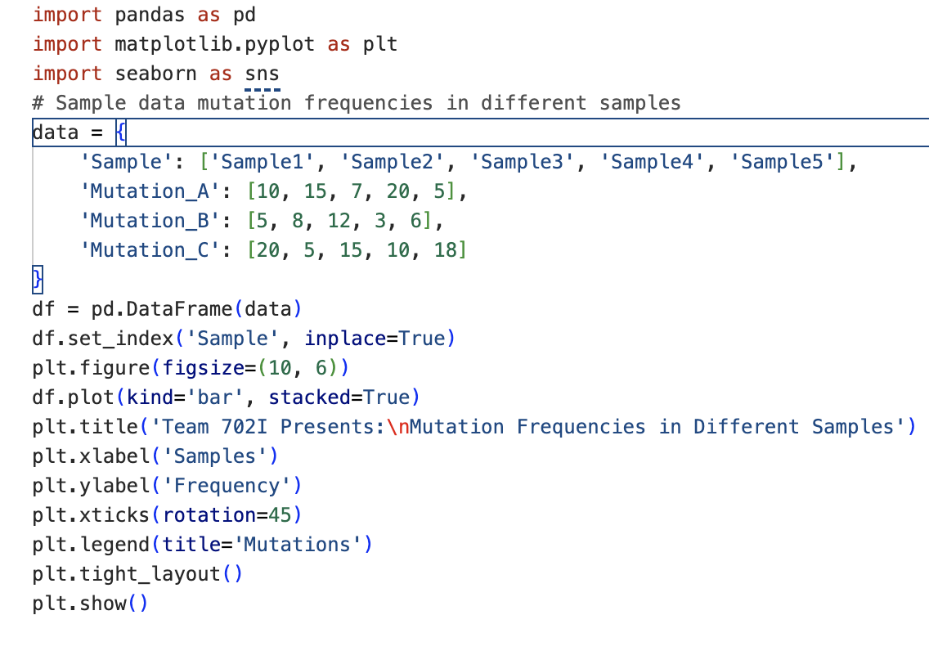
Creating Visualizations
Harish - Python & Mohit - Matplotlib
Roles of Python and Matplotlib in creating the stacked bar chart.
Code snippet focusing on Matplotlib functions for stacked bar plot.
Explanation of the code functionality.

Slide 6

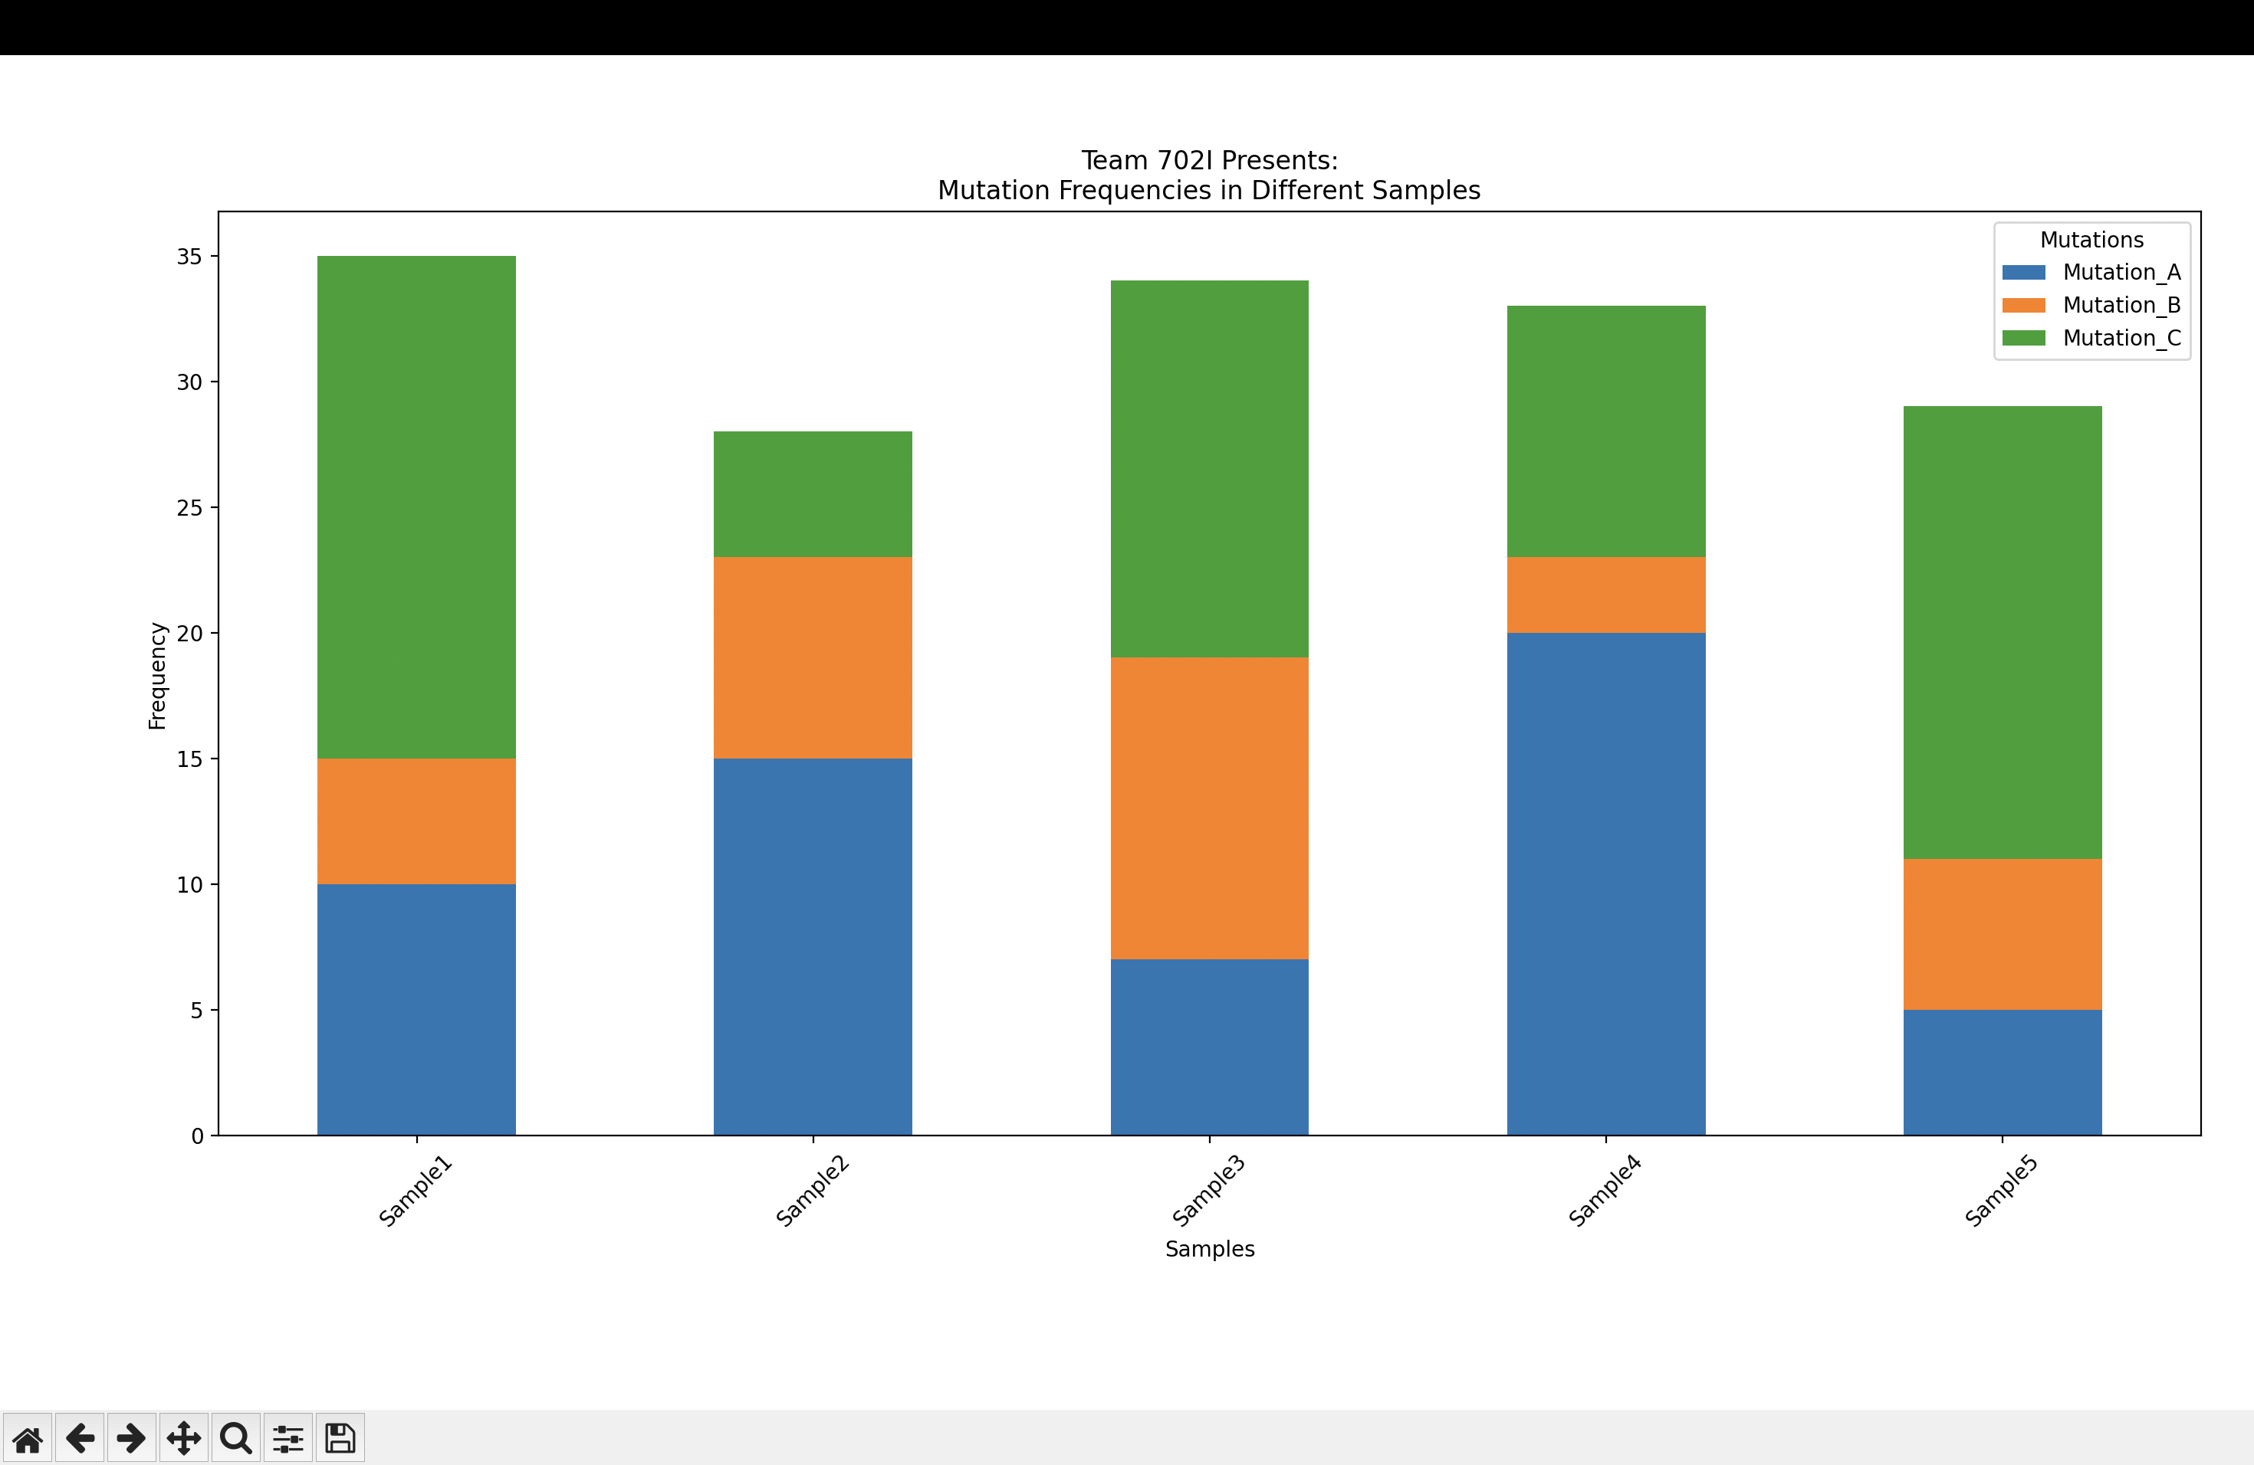
Enhancing with Seaborn
Vinu - Seaborn
Seaborn used for aesthetics and color selection.
Seaborn improves readability and styling of Matplotlib plots.
Adjustments made for color clarity in mutations (A, B, C).

Slide 7

Mutation Frequencies in Different Samples
Final visualization explanation: Mutation A, B, C frequencies across samples.
Each color-coded mutation's frequency represented across samples.
Observed patterns and findings in the data.

Slide 8
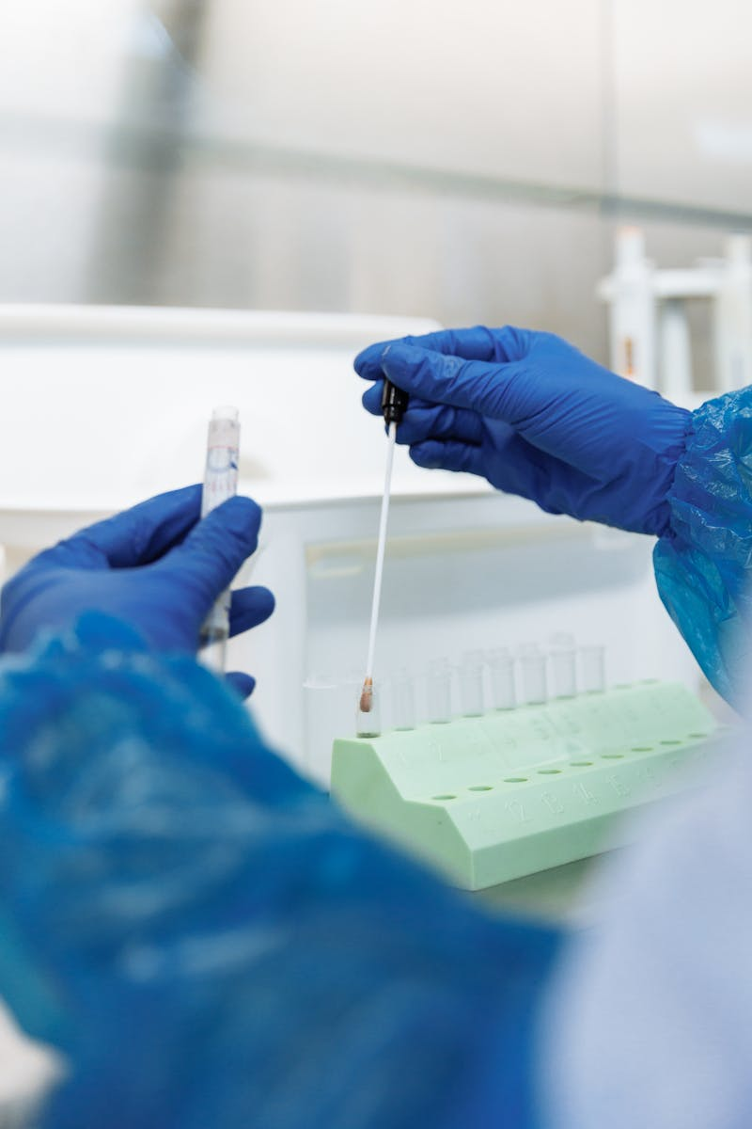
Conclusion & Learnings
Project outcome: Successful visualization of mutation data.
Key takeaways and challenges: Pandas, Matplotlib, and Seaborn skills.
Potential future applications of this project.

Slide 9

Q&A
Questions & Discussion

